Slide 1
CS6650 Midterm Mastery
Steps I – III: From HW6 Results to Crash & Recovery
Weifan Li | Distributed Systems | February 2026
Go
ECS Fargate
Terraform
Locust
Circuit Breaker

Slide 2




Agenda
Step I: HW6 Results
Single instance bottleneck → horizontal scaling with ALB
Step II: Key Learnings
CAP, MapReduce, IaC, Parnas, and hands-on scaling
Step III: Crash Demo
Cascading failure with a slow downstream service
Step III: Recovery
Fail Fast + Circuit Breaker + Bulkhead patterns

Slide 3
Step I: Homework 6 Results
Go Product Search Service on ECS Fargate (0.25 vCPU, 512 MB)
Part II: Single Instance
Part III: ALB + Auto Scaling
CPU scaled linearly with concurrency
Memory stayed flat (~11%)
→ CPU-bound workload confirmed
500 users for 5 minutes
Auto Scaled: 2 → 3 → 4 instances
Zero failures, stable response time
15% CPU
46% CPU
80.7%
~30s
5 Users
50 Users
CPU Peak
Recovery
Takeaway: Horizontal scaling with ALB is the correct long-term solution for stateless, compute-bound services.

Slide 4
Step II: What I Found Valuable
CAP & FLP
MapReduce
Terraform + Docker
Partitions are inevitable. The real choice: consistency or availability?
Constrained abstractions enable automatic parallelization and fault tolerance.
From 20 clicks to one command. IaC enables reproducibility at scale.
Parnas (1972)
HW6 Scaling
Failure Models
Information hiding → microservice boundaries. 50-year-old ideas still relevant.
Theory met practice: CPU bottleneck → ALB + Auto Scaling → problem solved.
8 Fallacies, halting/omission/Byzantine failures — vocabulary for real problems.

Slide 5
Step III: Crash & Recovery Architecture
Search Service
(port 8080)
100K products
sync.Map
ALB
(port 80)
Rec Service
(port 8081)
FAILURE
INJECTION
Locust
20 Users
Modes: none | slow (3-8s) | error | crash
RESILIENCE=false: waits forever, cascading failure
RESILIENCE=true: timeout + circuit breaker + bulkhead
Deployed via Terraform to AWS ECS Fargate | Service Discovery for inter-service communication

Slide 6

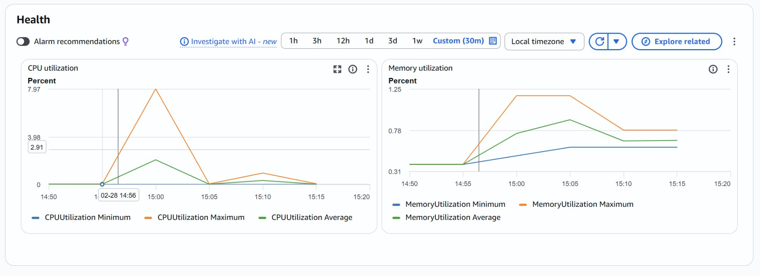

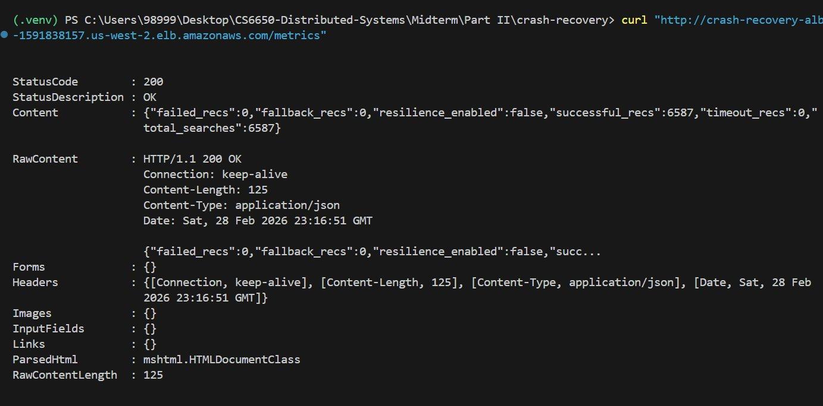
Phase 1: The Crash
No resilience — downstream goes slow (3-8s), everything dies
Metric | Baseline | Under Failure | Impact
RPS | 89 | 4 | −95%
Avg Latency | 16 ms | 4,644 ms | 290x
Median | 15 ms | 5,200 ms | 347x
Max | 151 ms | 8,015 ms | 53x
CloudWatch: CPU < 8% — bottleneck is I/O, not CPU
Key Insight: The system didn't return errors — it returned successful responses, just 290x slower. Every goroutine blocked waiting for the slow downstream, creating a silent cascading failure.
resilience_enabled: false, all requests slow but "successful"

Slide 7


Phase 2: The Fix
Three resilience patterns from Sam Newman's Building Microservices
Fail Fast
Circuit Breaker
Bulkhead
500ms Timeout
5 fails → OPEN
Max 10 concurrent
Don't wait 3-8s for a slow service. Time out after 500ms and return fallback data.
After 5 timeouts, stop calling downstream for 15s. Serve cached fallback instantly.
Only 10 goroutines can wait on downstream at once. The rest get fallback immediately.
Result: Same failure conditions (downstream in slow mode), RPS recovered from 4 → 89. Avg latency from 4,644ms → 18ms. Zero failures.
One Terraform variable change: resilience_enabled = false → true, terraform apply

Slide 8
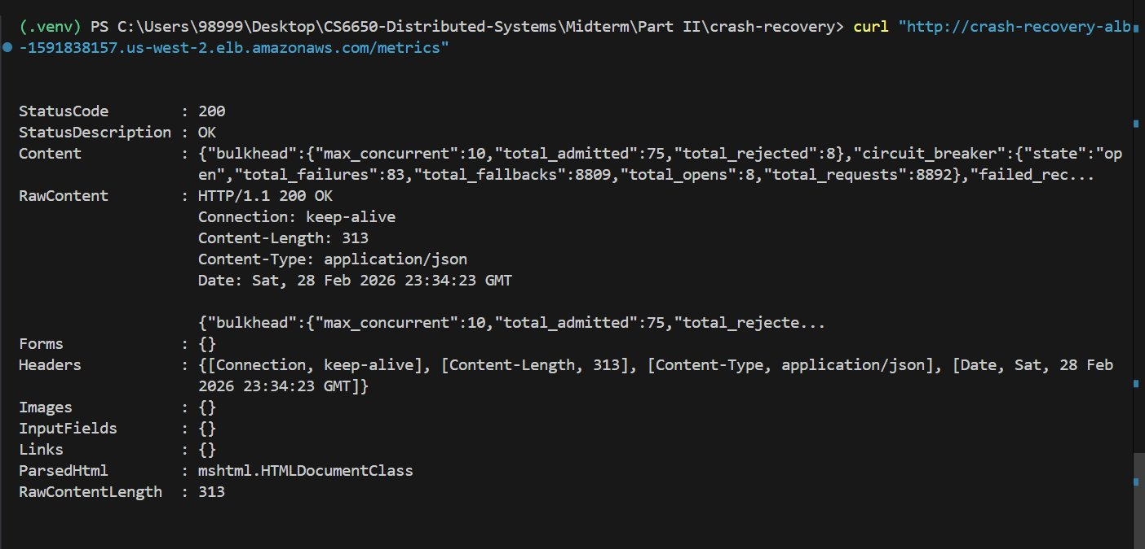
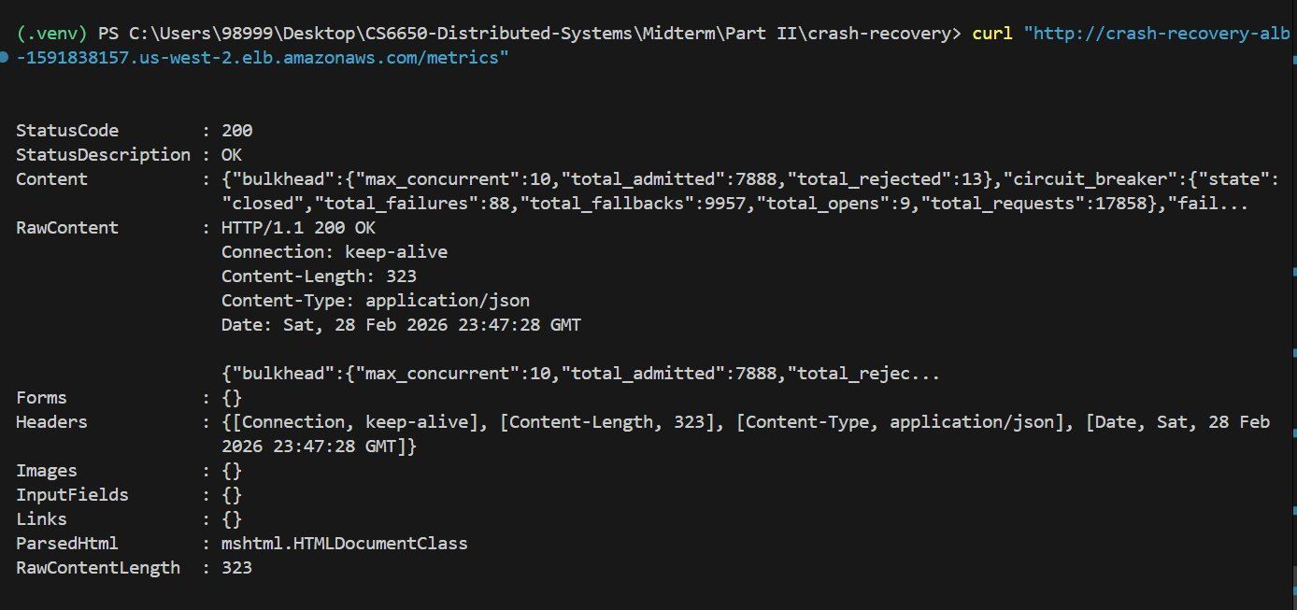
Full Results Comparison
Circuit breaker: OPEN, 8,809 fallbacks
Circuit breaker: CLOSED, fully recovered

Slide 9
Key Takeaways
01
Cascading failures are silent killers
No errors, just 290x slower. Monitor throughput, not just error rates.
02
CPU ≠ the bottleneck
CPU was 8% during the crash. I/O wait from blocked goroutines was the real problem.
03
Defense in depth works
Fail Fast + Circuit Breaker + Bulkhead = 100% throughput recovery under identical failure.
04
Degrade gracefully, don't fail hard
Fallback recommendations > 8-second timeouts. Users stay happy.

Slide 10
Thank You
Questions?
Weifan Li | CS6650 Distributed Systems | February 2026
Code: GitHub | Infra: Terraform + ECS Fargate | Testing: Locust

